Slide 1
Key Findings : Booking, Pricing and Popular Routes Analysis
Presented by Riddhish Joshi

Slide 2
Table of Content
Content
Problem Statement
Data Overview
Analysis
Strategy
1
2
3
4

Slide 3
Problem Statement
Problem Statement
Data Overview
Analysis
Strategy
1
Conduct a comprehensive analysis of the dataset to identify significant short-term and long-term patterns in bookings, pricing, and popular routes.
2
Analyze underlying causes for the observed trends and patterns in the data
3
Develop strategic recommendations aimed at improving overall sales, customer retention, and profitability for the OTA

Slide 4
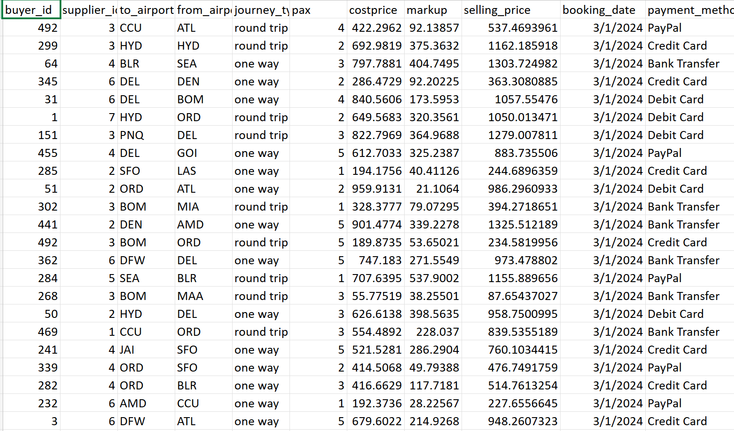
Problem Statement
Data Overview
Analysis
Strategy
Data Overview: Booking data (Online Travel Agency)
Supplier ID: Represents the unique suppliers from whom flights were purchased for resale.
Buyer ID: Denotes the unique ID of the customer making the booking.
From Airport: The departure airport for the flight.
To Airport: The arrival airport for the flight.
Journey Type: Indicates whether the trip is one-way or a round trip.
Pax: The number of passengers traveling in a booking.
Payment Method: The method of payment used, such as credit cards or online wallets.
Booking Date: The date on which the booking was confirmed and payment was made.
Channel of Booking: The platform used for booking, such as iOS, Android, or web.
Fig. 1.1 Booking data from an Online Travel Agency

Slide 5
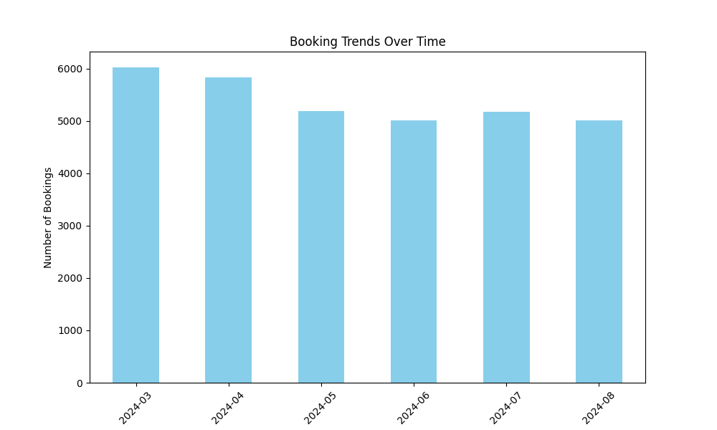
Problem Statement
Data Overview
Analysis
Strategy
Analysis: Booking Trends
Observation
Fluctuating booking volumes from March to August 2024
Peak in March and April, followed by a decline
Analysis
High bookings due to spring breaks of the financial year
Decline linked to low travel frequency in the summer

Slide 6
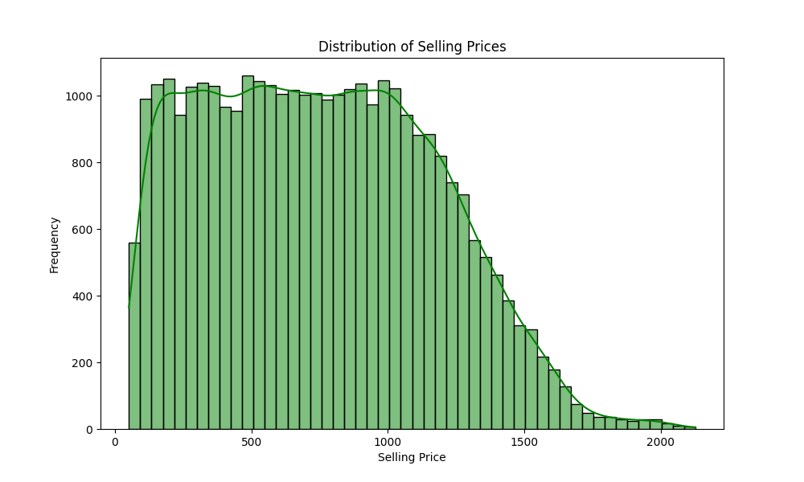
Problem Statement
Data Overview
Analysis
Strategy
Analysis: Selling Price Distribution
Observation
Prices mostly range from 400 to 1000
Right-skewed distribution, few high-priced outliers
Analysis
Budget-conscious customers dominate
High-end or long-haul flights contribute to outliers

Slide 7
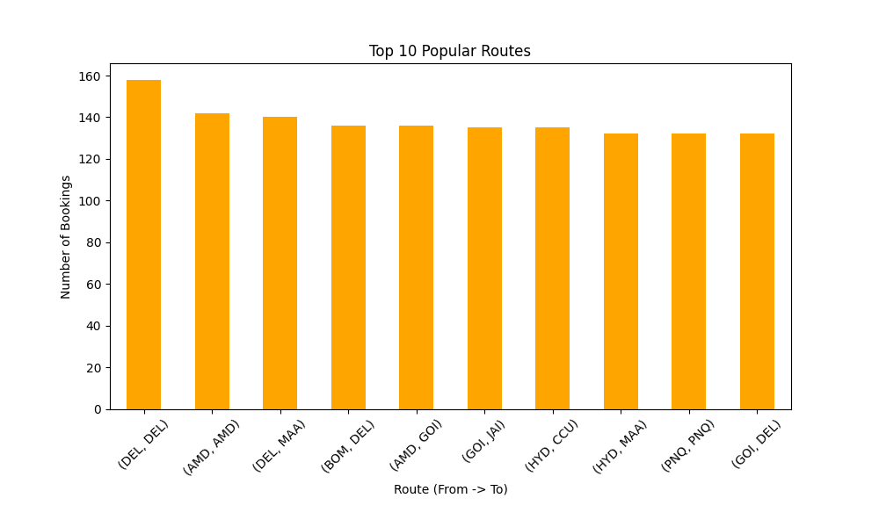
Problem Statement
Data Overview
Analysis
Strategy
Analysis: Popular Routes
Observation
Major airports: DEL, BOM, AMD
Frequent round trips (e.g., DEL to DEL)
Analysis
Popular business/tourist destinations
Round trips may indicate multi-leg journeys or data entry errors

Slide 8
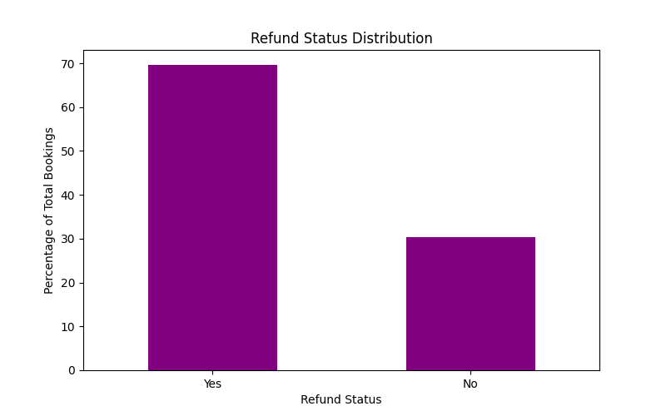
Problem Statement
Data Overview
Analysis
Strategy
Analysis: Refund Analysis
Observation
Over 10% of bookings resulted in refunds
Analysis
Possible supplier issues or customer dissatisfaction
Impact on profitability and operational costs

Slide 9
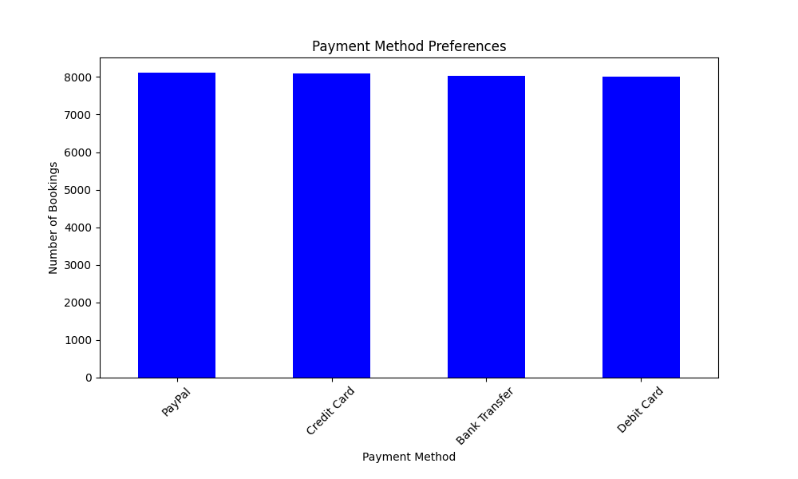
Problem Statement
Data Overview
Analysis
Strategy
Analysis: Payment Method Preferences
Observation
Credit Cards and PayPal are commonly used
Different payment methods have varying average selling prices
Analysis
High-spending customers prefer certain methods
Budget-conscious customers use lower-price methods

Slide 10
Problem Statement
Data Overview
Analysis
Strategy
Suggested Strategy
Promotional Campaigns : Run discounts in low seasons
Tiered Pricing Strategy : Offer bundled services to attract higher spenders
Route-Specific Marketing : Focus on loyalty programs for popular routes
Reduce Refund Rates : Analyze suppliers and offer flexible booking options
Targeted Payment Promotions : Encourage high-spending payment methods

Slide 11
Thank you

